Slide 1
New UHF TRx– Weekly meeting
Marco Panetti
Date: 2023/02/01

Slide 2
Current status
Subsystem | Task | Responsible | Status | Priority | Deadline | %done
New UHF | 1. Sending Tharindu-san components | Marco | Export documents in preparation (by Kawano san) | High | As soon as possible | 50%
 | 2. Procurements for TRx Board | Marco | Order secured | High | As soon as possible | 50%
 | 3. Order another component for Tharindu | Marco | Not done yet, Does anyone need to make a procurement? | Medium | Tharindu: “No Hurry” | 0%

Slide 3
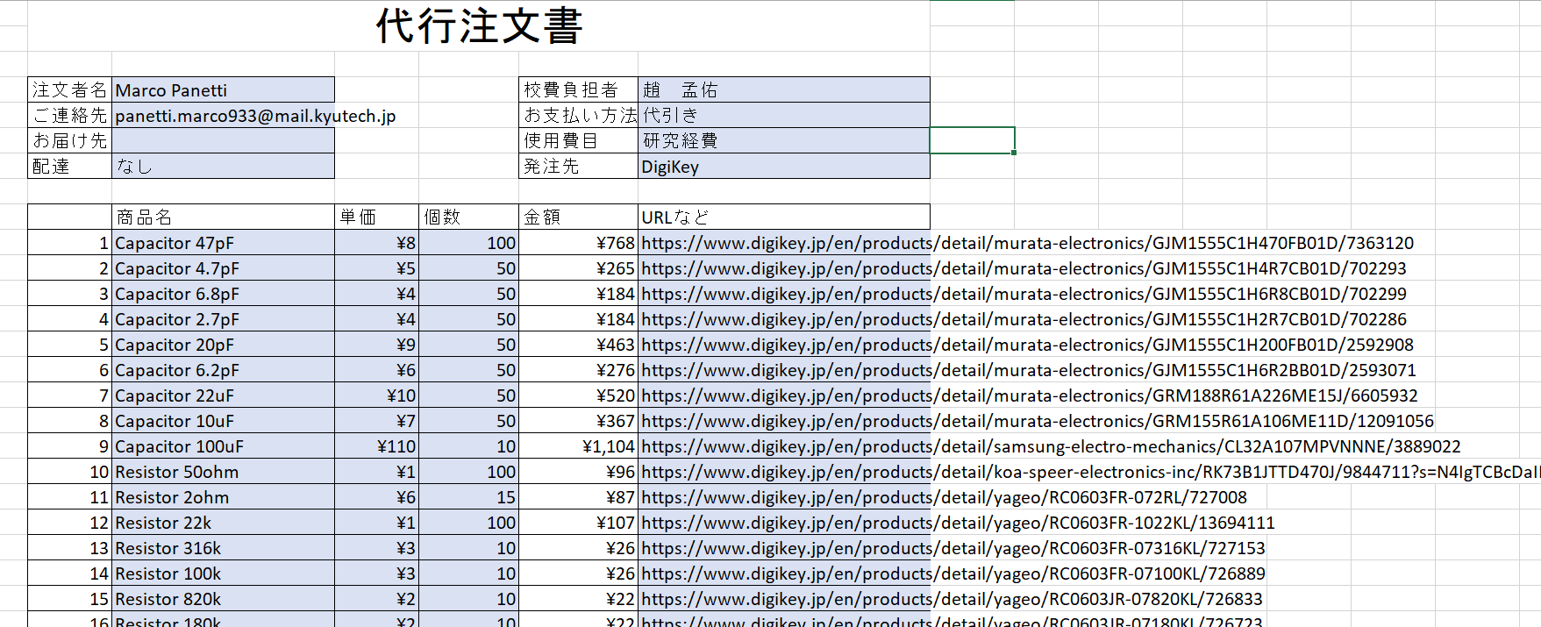
Order Secured:
…

Slide 4
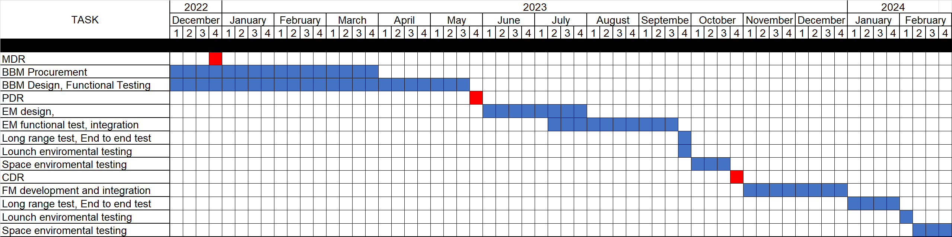
Schedule

